Slide 1
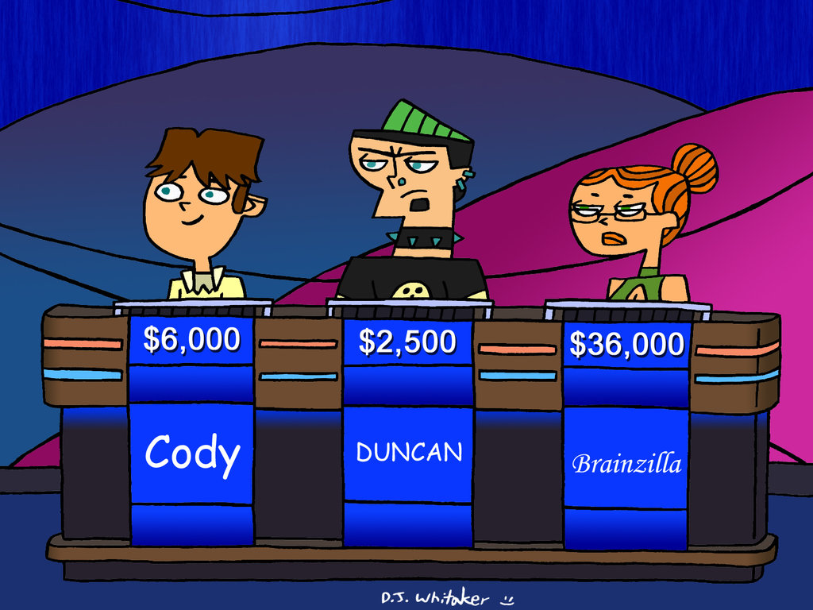
Jeopardy Countries and Nationalities

Slide 2
CITIES - COUNTRIES
A | B | C | D
100 | 100 | 100 | 100
200 | 200 | 200 | 200
300 | 300 | 300 | 300
400 | 400 | 400 | 400
500 | 500 | 500 | 500

Slide 3
For 100 points…
The capital city of Brazil is…

Slide 4
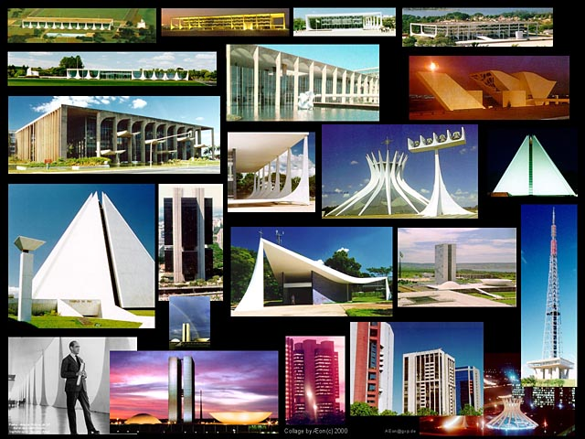

Brasilia

Slide 5
For 100 points…
What is the capital of Egypt?

Slide 6
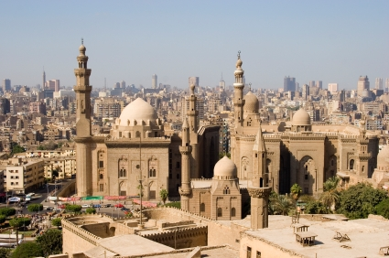
Cairo

Slide 7
For 300 points…
“The Big Apple” is also…
Name the city.

Slide 8
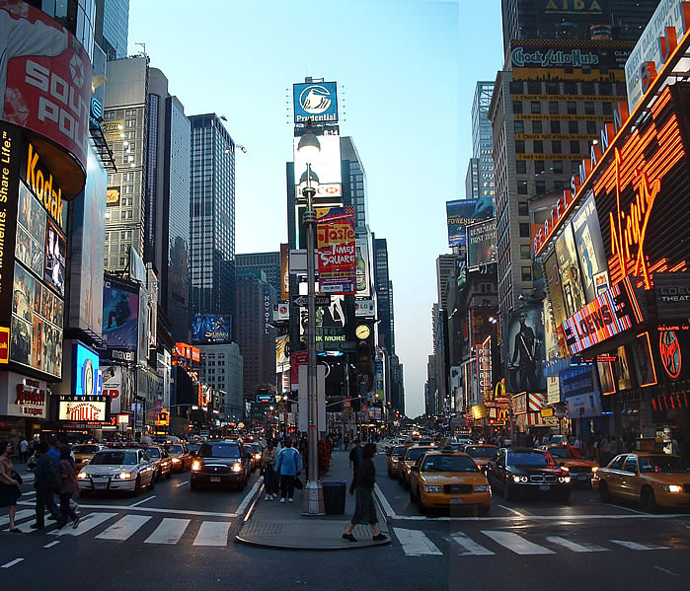
New York City

Slide 9
For 200 points…
What is the capital of Indonesia?

Slide 10
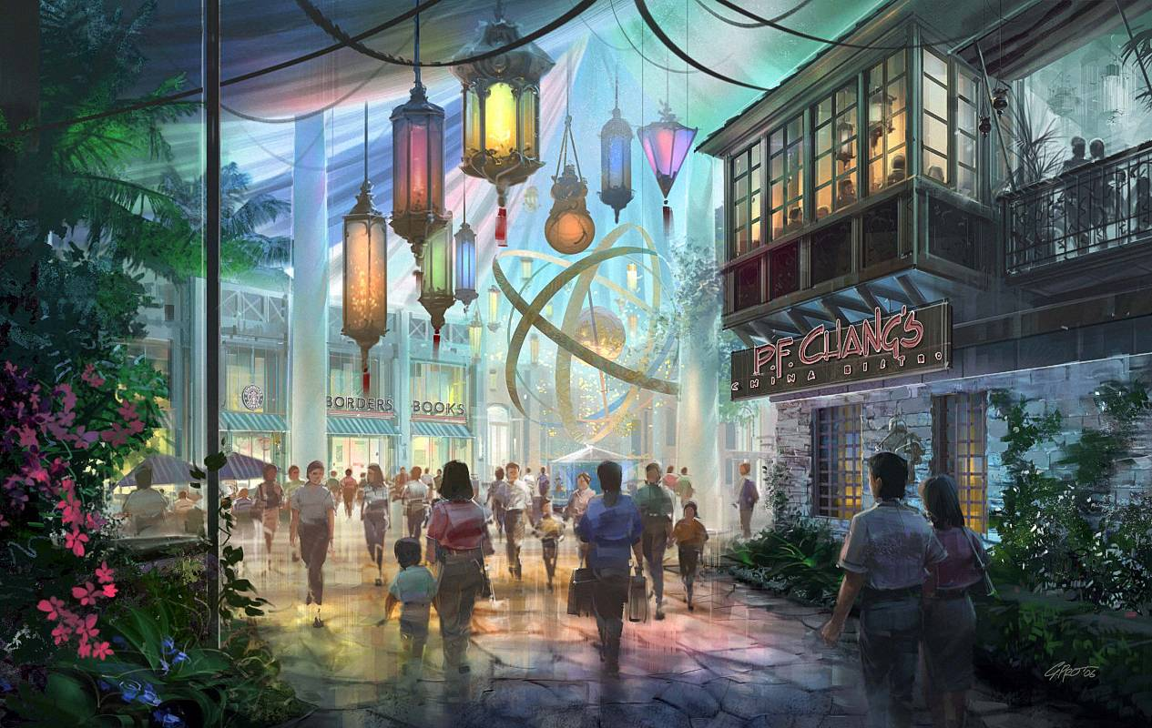
Jakarta

Slide 11
For 300 points…
The streets of this Italian city are made of water.
Name the city.

Slide 12
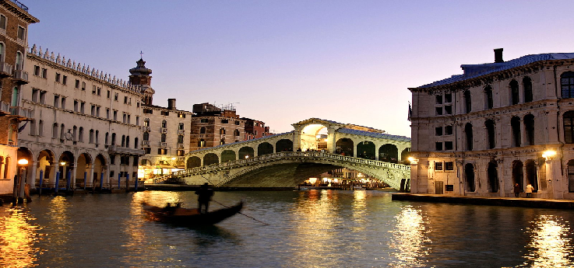
Venice

Slide 13
For 400 points…
The island is in the South of China.
The island’s name today is…

Slide 14
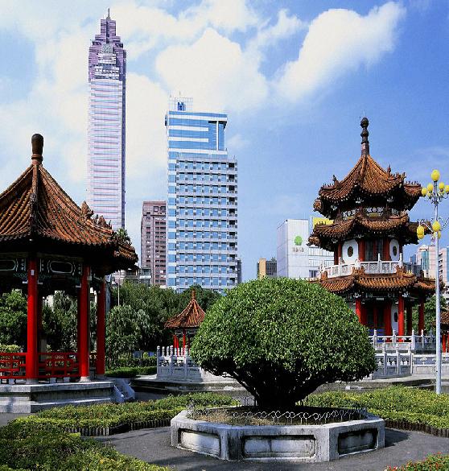
Taiwan

Slide 15
For 100 points…
What is the nationality of a person from Japan?

Slide 16
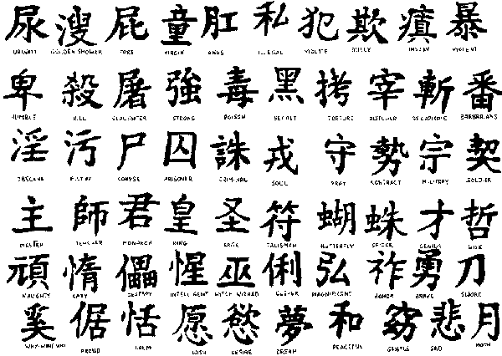
Japanese

Slide 17
For 200 points…
Who lives at the White House in Washington, D.C?

Slide 18
The President of the United States

Slide 19
For 100 points…
What is the nationality of a person from Colombia?

Slide 20
Colombian

Slide 21
For 300 points…
Name the two main languages in Canada.

Slide 22
English
and French

Slide 23
For 200 points…
Where is the city of Paris?
Name the country

Slide 24
It’s located in France.

Slide 25
For 400 points…
Where is the Sydney Opera House?
Name the country

Slide 26
It’s located in Australia.

Slide 27
For 300 points…
Santiago is the capital of this South American country.
Name the country

Slide 28
Chile

Slide 29
For 300 points…
Where is your teacher from?

Slide 30
The teacher is from Peru.

Slide 31
For 400 points…
Car maker Mercedes Benz is from this country.
Name the country

Slide 32
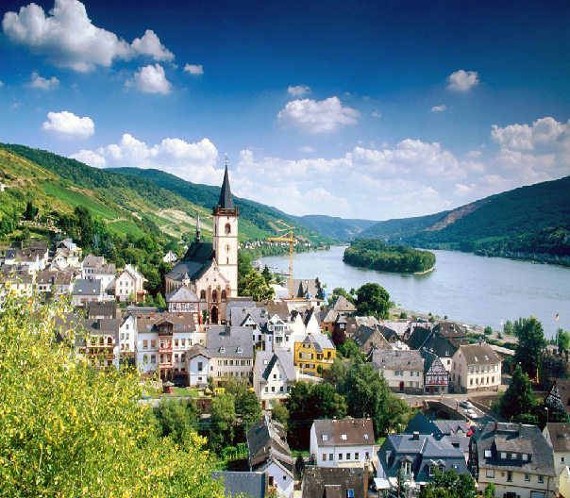
Germany

Slide 33
For 500 points…
Where is the Colosseum?
Name the City and the country.

Slide 34
It’s located in Rome, Italy.

Slide 35
For 300 points…
Mozart was form...
Name the country

Slide 36
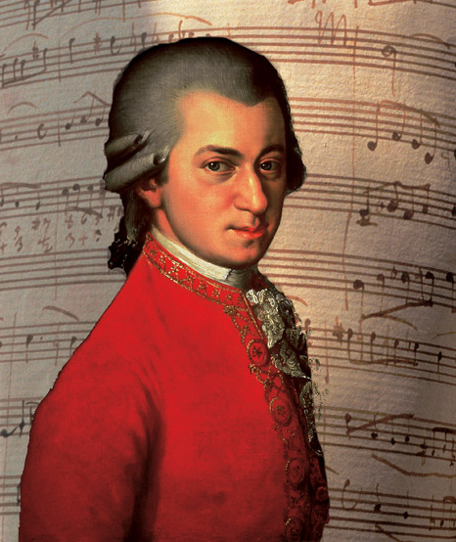
Austria

Slide 37
For 500 points…
Name three Wonders of the World.

Slide 38
Great Wall of China
Petra
Christ the Redeemer
Machu Picchu
Chichen Itza
Colosseum
Taj Mahal

Slide 39
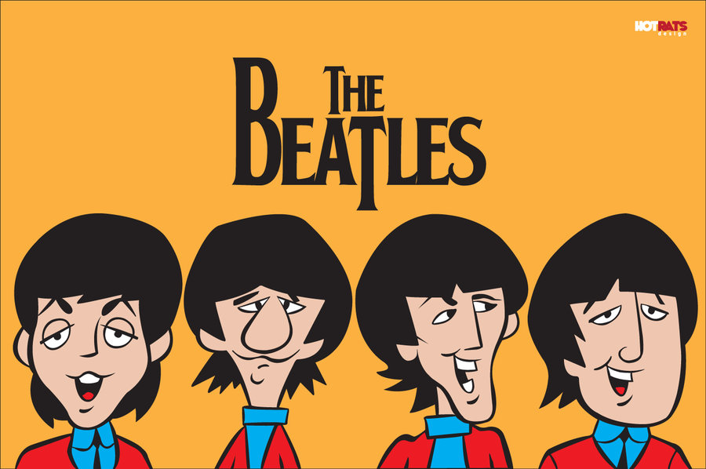
For 500 points…
Where are they from?
Name the country

Slide 40
They are from England.

Slide 41
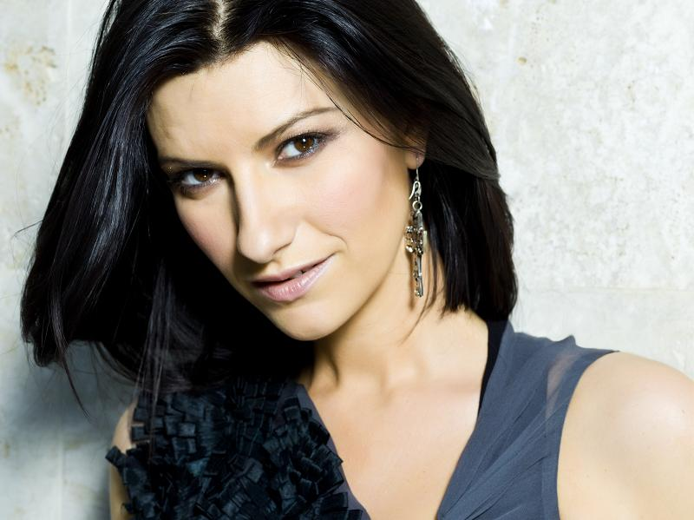
For 200 points…
Where is she from?

Slide 42
She is from Italy.

Slide 43
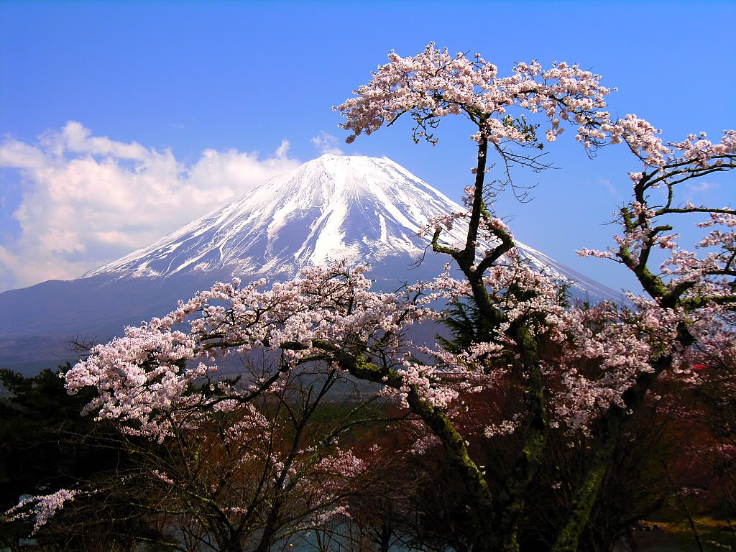
For 500 points…
The mount Fuji is…

Slide 44
Japan

